Slide 1
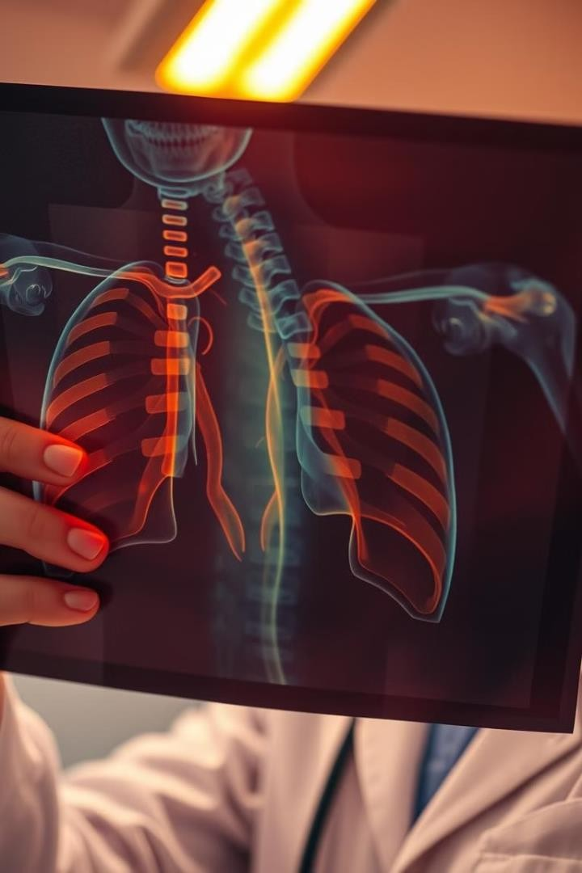
AI-driven Disease
Detection from X-Ray Images
This project explores the development of an AI model capable of detecting various lung diseases from chest X-ray images and generating comprehensive reports.
Mostafa Fawzy Abdelrahman Walid Moataz nasr Mahmoud naser Yousef atef

Slide 2

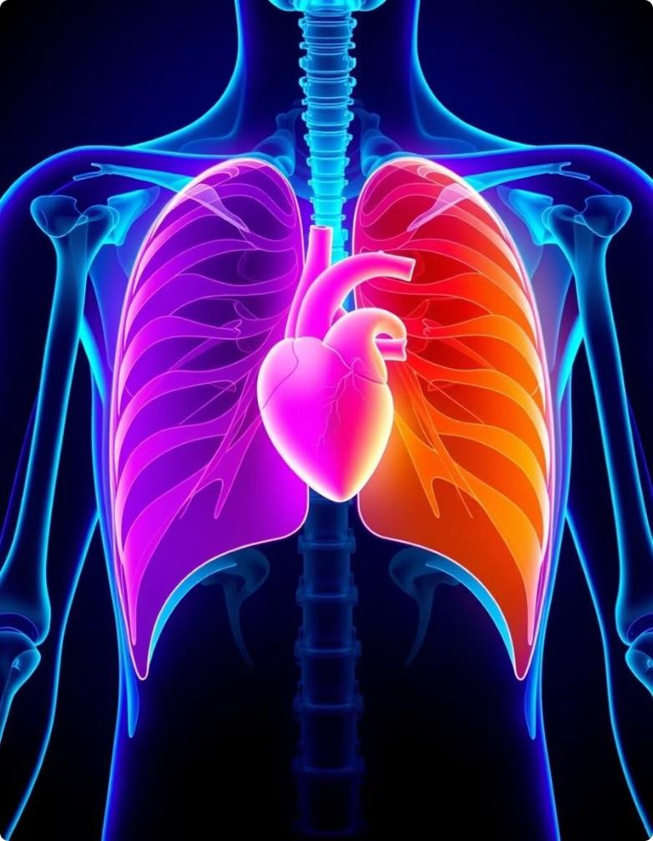
Exploratory Data Analysis (EDA) for Images and Reports
1
Image Analysis
Analyzing the distribution of different lung diseases, their prevalence, and potential correlations.
2
Text Analysis
Identifying key terms, phrases, and patterns in the radiology reports that provide insights into diagnoses.
3
Data Ǫuality Assessment
Evaluating the quality and consistency of the data, addressing any
inconsistencies or missing information.

Slide 3

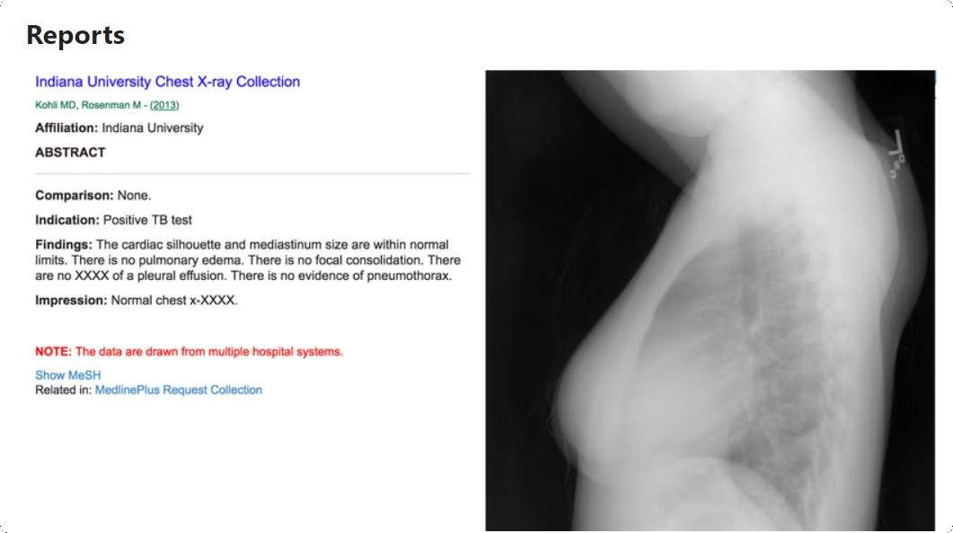
The objective of this case study is to develop a deep learning model that automates the generation of the impression section of medical reports based on chest X-ray images, helping reduce the workload of medical professionals. Typically, writing these reports takes 5-10 minutes per case, and with doctors needing to generate reports for hundreds of images daily, automating the process can save significant time. The study uses a publicly available Indiana University Chest X-ray dataset, which includes both images and corresponding medical reports in XML format. The focus is on predicting the impressions from the X-ray images, aiming to assist doctors by automatically generating this critical part of the report.

Slide 4
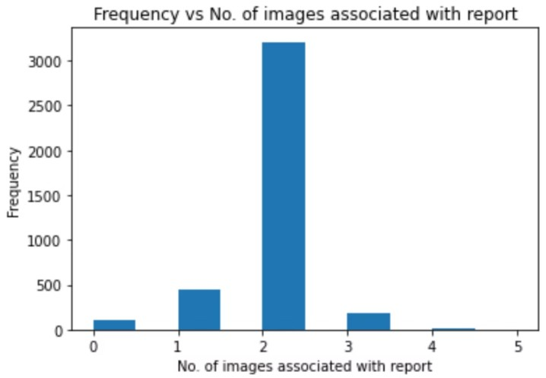
We can see that the maximum number of images associated with a report can be 5 while the minimum is 0

Slide 5

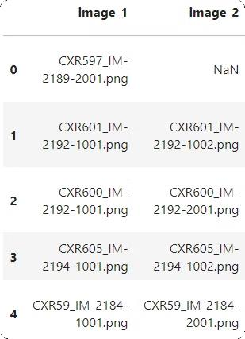
we will take 2 images as input as 2 images are highest frequency of being associated with a report
For 1-image report we will use the same image as second image

Slide 6

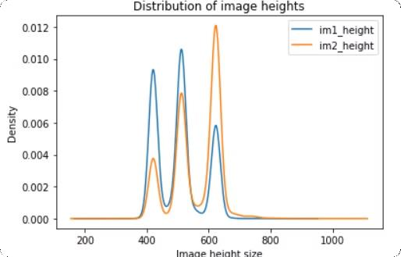
Width for both of the images have only 1 unique value for all datapoints and that is 512. Since
pretrained models are modelled for square-sized images we can choose 512512 as the specified size of the image. Hence we can resize all images into 512512 shape.

Slide 7
Leveraging ChexNet as Image Feature Extractor
Pre-trained Model
Feature Extraction
Transfer Learning
Utilizing a pre-trained ChexNet model, trained on a large dataset of chest X- rays for image feature extraction.
Extracting high-level features from input X-ray images, capturing crucial information for disease detection.
Leveraging the knowledge acquired by ChexNet on a large dataset to improve our model's performance on the specific task.

Slide 8
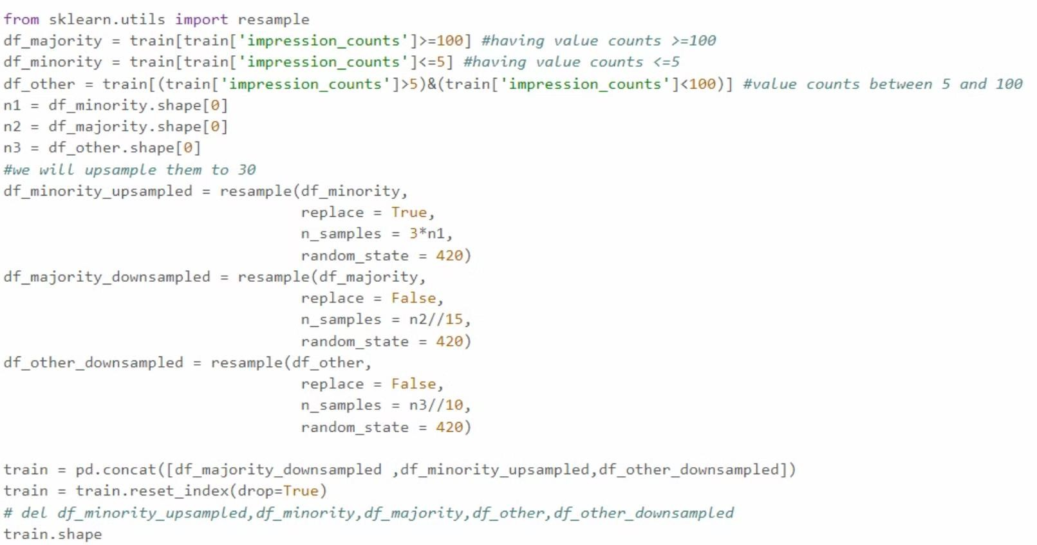

Slide 9

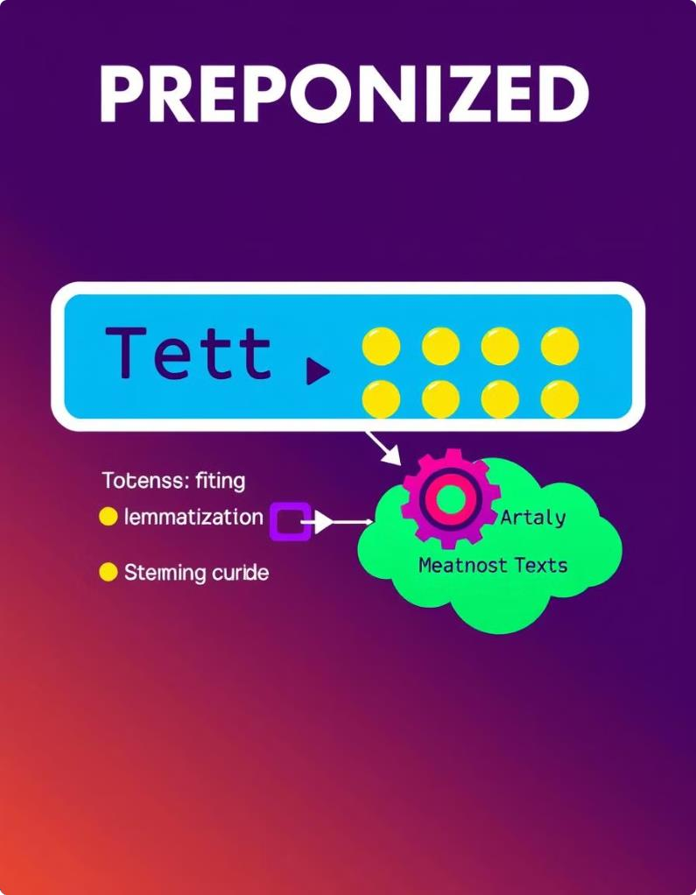
Text Tokenization and Preprocessing
1
Tokenization
Splitting the text reports into individual words or tokens, creating a representation suitable for machine learning.
2
Normalization
Converting words to lowercase, removing punctuation, and applying other transformations for consistent representation.
3
Stemming/Lemmatization
Reducing words to their root form, improving the model's ability to generalize across variations of words.
4
Stop Word Removal
Eliminating common words that hold little semantic value, focusing the model on meaningful terms.

Slide 10

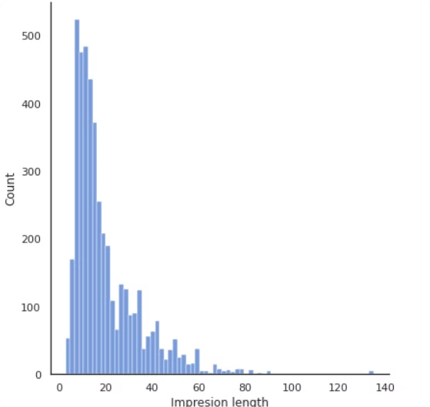
The max and min value of "caption length" was found to be 135 and 3 respectively The 80 percentile value of caption_len which is 2Y will be taken as the maximum padded value for each impression

Slide 11
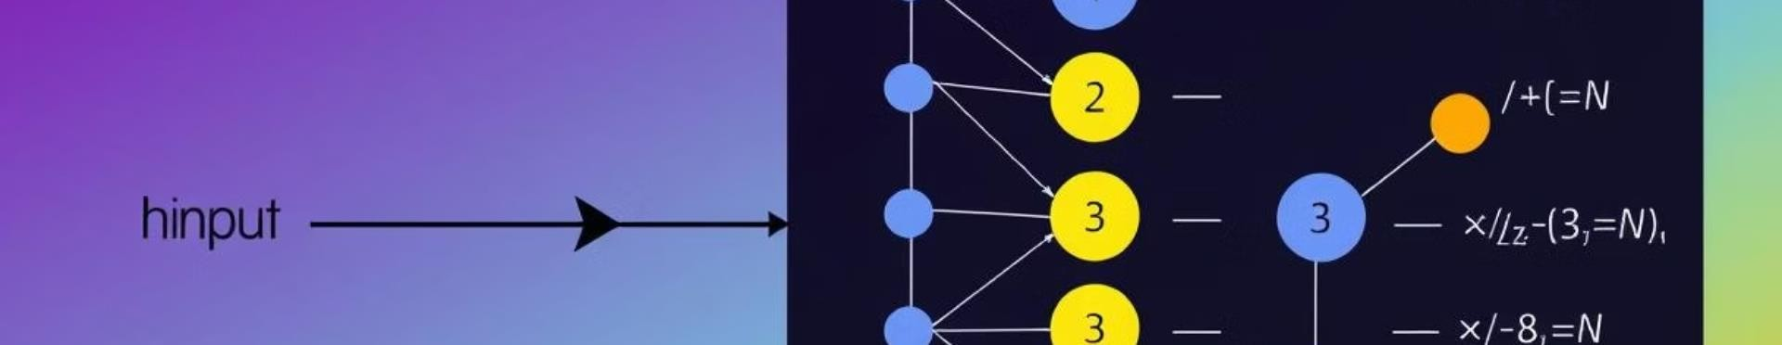
Developing a Simple Classification Model
Input Layer
Takes the extracted image features and preprocessed text tokens as input.
Hidden Layers
Combines image and text information to learn complex relationships and patterns.
Output Layer
Generates probabilities for each disease class, indicating the model's prediction for the presence or absence of a disease.

Slide 12

Evaluating Model Performance
The BLEU score will be used as a metric to evaluate the model by comparing words in the predicted sentence to the reference sentence using n-grams. However, BLEU has limitations, as it penalizes similar words with the same meaning. To address this, in addition to n-gram BLEU scoring, a sample of the predicted captions will be manually compared to the original reference captions to provide a more accurate assessment of performance.

Slide 13

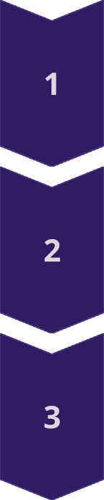
Introducing an Attention-based Model
Attention Mechanism
Focuses on specific parts of the input image and text that are most relevant to disease prediction.
Weighting Importance
Assigns weights to different features, emphasizing those that contribute most to the final prediction.
Improved Accuracy
By focusing on relevant information, the model can achieve higher accuracy and better generalization.

Slide 14

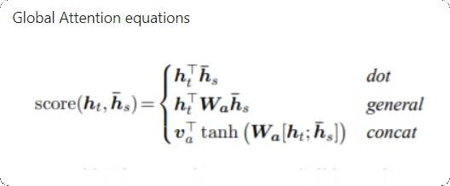
An attention model is used to enhance the performance of sequence-based tasks, like image
captioning or translation, by allowing the model to
focus on the most relevant parts of the input when generating each part of the output.

Slide 15

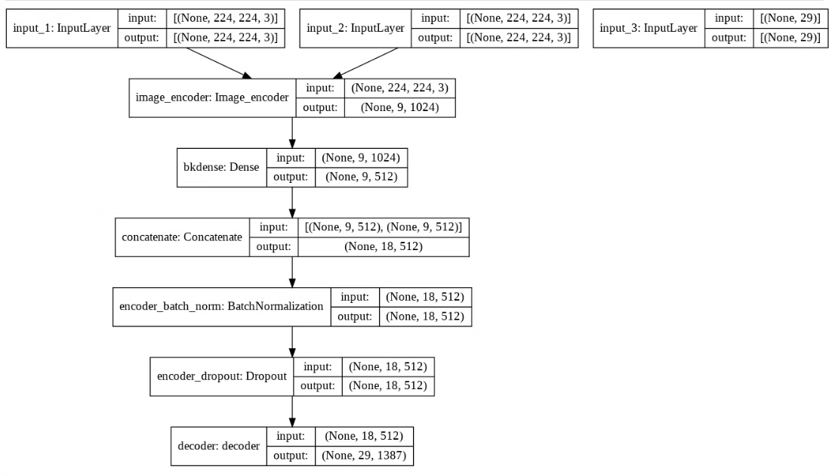
Architecture of the AI model showcasing the greedy search mechanism. The model processes image
inputs, encoding them into dense feature
representations, followed by concatenation and batch normalization, before reaching the decoding stage, where the output is generated by selecting the optimal steps sequentially, based on immediate gains.

Slide 16
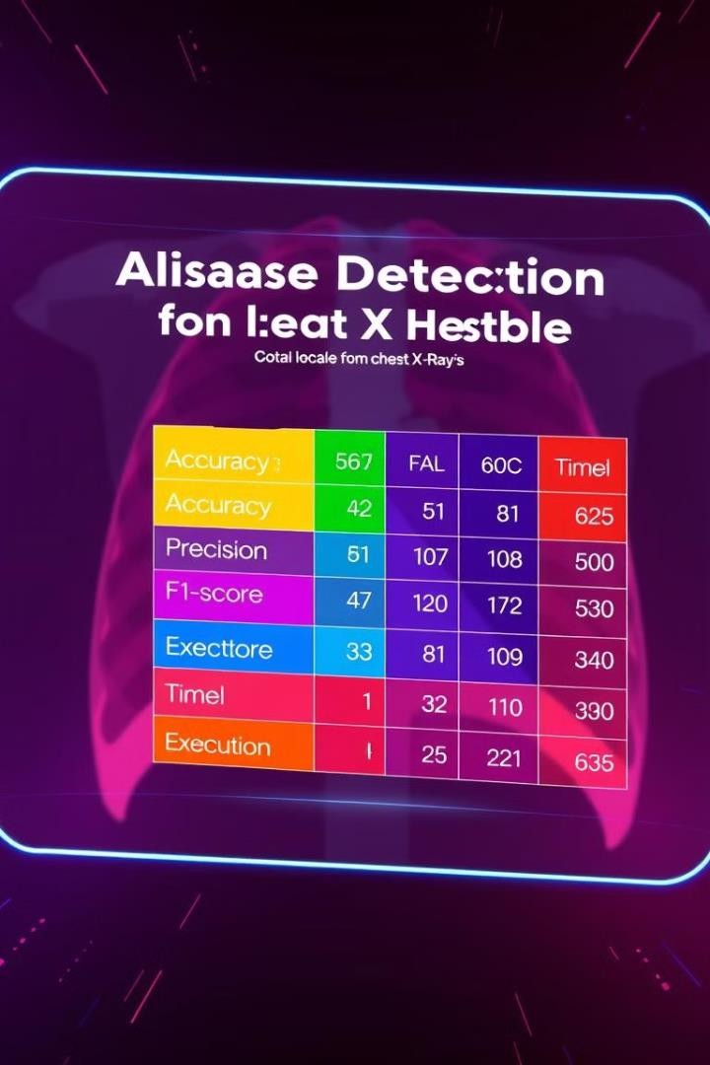



Testing and Comparing Model Outcomes
Performance Evaluation
Evaluating the performance of both simple and attention-based models on a separate test set to assess generalization.
Model Comparison
Comparing the accuracy, precision, recall, and other metrics of the models to determine which performs better.
Report Generation
Using the best-performing model to generate comprehensive reports for each X-ray image, providing detailed information about the detected diseases.

Slide 17

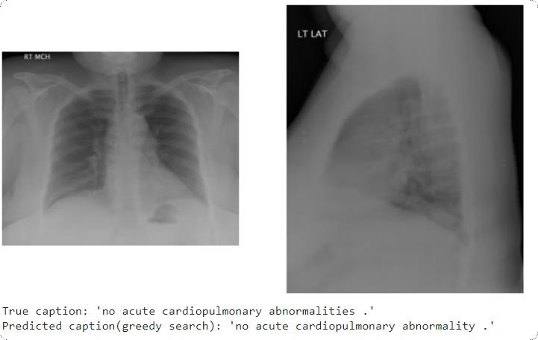
This model performed better than simple baseline model since it produced captions which had higher
variablity and also remained lingusitically similiar.
Even then we can see that most of datapoints were of normal chest or no disease category we need to collect more dataset which have x-rays of patients having diseases so that to improve the model's performance. Even the model predicted tough captions which had similiar meaning to the true ones. Beam search was found to take large amount of time in predicting even 1 caption so it was discarded.

Slide 18

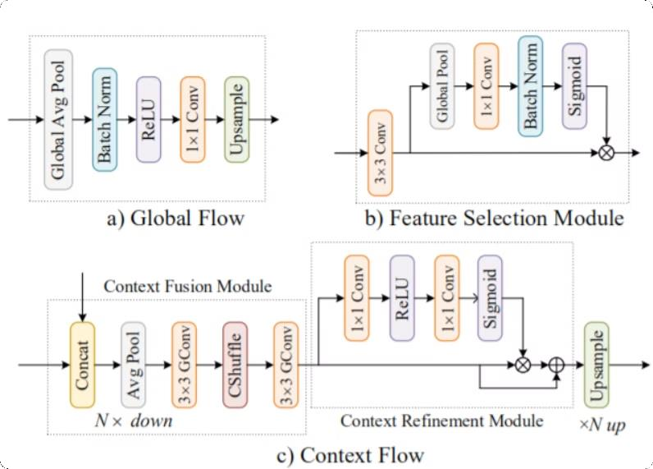
Custom Final Model
This architecture implementation is taken from Attention guided chained context aggregation for image segmentation which was used for image segmentation but I will use it to extract image information. Here what I will do is that the outputs from Image encoder (ie chexnet) will be sent to global flow. Then outputs from both the chexnet and global flow will be concatted and sent to context flow. Here global flow extracts the global information of image while context flow will get the local features of the images. This will be then sent to decoder after reshaping, and applying batch norm and dropout.

Slide 19
Conclusion
This model performed better than simple baseline model since it produced captions which had higher variablity and also remained lingusitically
similiar. Even then we can see that most of datapoints were of normal chest
or no disease category we need to collect more dataset which have x-rays of patients having diseases so that to improve the model's performance. Even the model predicted tough captions which had similiar meaning to the true ones. Beam search was found to take large amount of time in predicting even 1 caption so it was discarded. An attention model is used to enhance the performance of sequence-based tasks, like image captioning or translation, by allowing the model to focus on the most relevant parts of the input when generating each part of the output.

